Slide 1
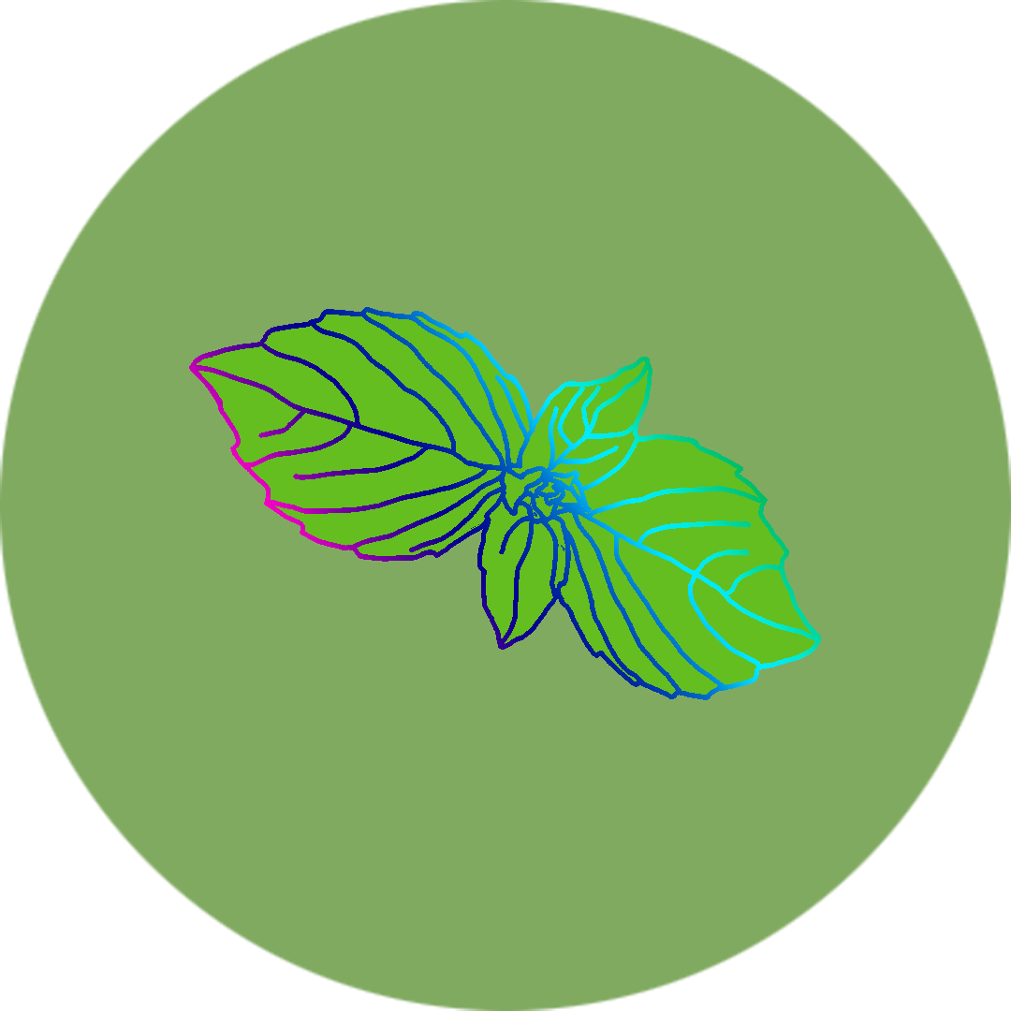
PlanteR-GB
Group 64
Winter is coming….
Zach Lerew, Travis Hodgin,
Max Schmidt, Austin Hodgin

Slide 2
Iteration 1
Iteration 0 accomplishes rough connectivity between the RGB strips and the microcontroller system. This means the Master controller can provide input to the LED controllers to manipulate trivial options like color and brightness. This iteration is only expected to take a maximum of 2 weeks, and may take closer to the end of those two weeks. This is the initial "get the ball rolling" iteration. It is expected there may be some complications getting used to the code environment, and getting the hardware up and running.

Slide 3
Iteration 2
Iteration 2 builds on Iteration 1 by making the LED controller look for values and configurations on the Master controller. These are scheduled statically. This is more of a testing iteration to see what the capabilities of communication are between the two controllers. This time will likely decrease. However, it still leaves time should any new issues arise in the details of the design.

Slide 4
Iteration 3
Iteration 3's largest feature is the scripting of the basic LED controls. A user may run a text based script to insert values into the control service. This updates the LEDs quickly, but may not be user friendly. This may also be a shortened iteration interval. The passing of data is completed, and a script is now taking over for manual updates. This script may also be the base for which future command line interfaces to the LEDs are made.

Slide 5
Iteration 4
This iteration sees the first basic functionality of scheduling the LED timings. Currently, the requirements state the iteration includes daily or weekly changes, but could also include hourly start timings for a specific LED state. Seeing as this iteration requires the implementation of a clock, and potentially multiple schedules running, this iteration could take the entire two weeks of the interval.

Slide 6
Iteration 5
Adding the largest functionality yet, Iteration 5 includes the implementation of LED zoning. Each zone has its own state and schedule. This iteration should almost certainly take the entire two week interval. This is due to the increased coding of the internal state housed by the master controller, which keeps a complete "image" of all zones, their specific LEDs, and schedules

Slide 7
Iteration 6
Further building upon the previous iteration, Iteration 5 increases the amount of LEDs that can be driven, and the amount of control zones. This provides more precise control, and more options for future customization. This iteration is not expected to take the full two allotted weeks. Spending less time at this stage gives wiggle room to the final iteration.

Slide 8
Iteration 7
Of the 7 iterations, Iteration 6 provides the largest boost of usability with a full fledged web interface. This web page, or set of pages, can provide the end user the graphical representation of the current planter bed and all its LEDs. It also gives them full control of color, brightness, zoning, and scheduling, all within a few clicks. This iteration should take the remaining time left. If it turns out that it is completed early, the next set of iterations can be attempted.

Slide 9
Conclusion
Features we would like to add
Mobile site improvements
Pre-build profile settings
3D printed planter box
Moisture and Temperature sensors.

